Slide 1


Test Automation Using Selenium
Fair Hike Academy
That’s the way the cookie crumbles!
Session 7: Java Programming – OOPS concepts
Mentor : Naresh Vulli, CSTE, PAHM.
fairhike@gmail.com www.fairhike.blogspot.com | www.facebook.com/fairhike

Slide 2
Today’s Topics
Recap
Object Oriented programming - Object and Class
Inheritance
Polymorphism
Access Specifiers
Encapsulation
Takeaways or Exercise

Slide 3
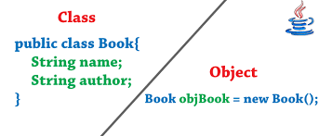
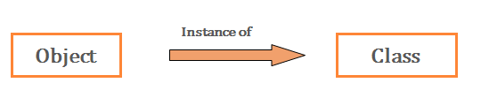
Object Oriented programming - Object and Class
Object Oriented Programming is a programming method that combines:
a) Data
b) Instructions for processing that data
into a self-sufficient ‘object’ that can be used within a program or in other programs.

Slide 4
Inheritance
Code Re-usability
Deriving a new class from existing class
Derived class or sub class or child class Extends Base class or super class or parent class
class Vehicle.
{
......
}
class Car extends Vehicle
{
....... //extends the property of vehicle class.
}

Slide 5
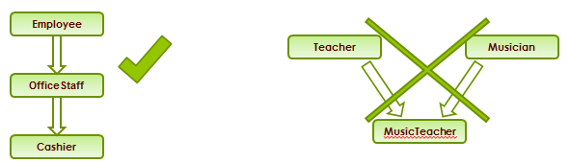
Inheritance Contd..
Multi-level inheritance is allowed in Java but not multiple inheritance

Slide 6
Polymorphism
Method Overloading: Overloading happens at compile time
Two or more method in a class have same name but different parameters
Method Overriding : Overriding happens at run time
An overridden method would have the exact same method name, return type, number of parameters, and types of parameters as the method in the parent class, and the only difference would be the definition of the method.

Slide 7
Polymorphism Example

Slide 8
Access specifiers
public: Accessible to all. Other objects can also access this member variable or function
private: Not accessible by other objects. Private members can be accessed only by the methods in the same class. Object accessible only in Class in which they are declared
protected: The scope of a protected variable is within the class which declares it and in the class which inherits from the class (Scope is Class and subclass)

Slide 9
Encapsulation
Encapsulation is a practice to bind related functionality (Methods) & Data (Variables) in a protective wrapper (Class) with required access modifiers (public, private, default & protected) so that the code can be saved from unauthorized access by outer world and can be made easy to maintain
We can achieve complete encapsulation in java by making members of a class private and access them outside the class only through getters and setters.

Slide 10
Takeaway or Exercise
Create and execute java programs with multi level Inheritance
Write a program to achieve Method overriding

Slide 11
Q & A

Slide 12
Thank You ☺

